Slide 1
For loop and Array

Slide 2
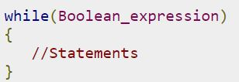
The while loop
A while loop is a control structure that allows you to repeat a task a certain number of times.
The syntax of a while loop is:
When executing, if the boolean_expression result is true, then the actions inside the loop will be executed. This will continue as long as the expression result is true.
Here, key point of the while loop is that the loop might not ever run. When the expression is tested and the result is false, the loop body will be skipped and the first statement after the while loop will be executed.

Slide 3
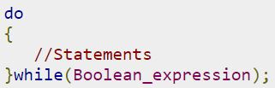
The do…while loop
A do...while loop is similar to a while loop, except that a do...while loop is guaranteed to execute at least one time.
The syntax of a do...while loop is:
Notice that the Boolean expression appears at the end of the loop, so the statements in the loop execute once before the Boolean is tested.
If the Boolean expression is true, the flow of control jumps back up to do, and the statements in the loop execute again. This process repeats until the Boolean expression is false.

Slide 4
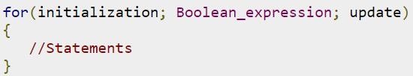
The for Loop
A for loop is a repetition control structure that allows you to efficiently write a loop that needs to execute a specific number of times.
A for loop is useful when you know how many times a task is to be repeated.
The syntax of a for loop is

Slide 5
The for Loop
The initialization step is executed first, and only once. This step allows you to declare and initialize any loop control variables. You are not required to put a statement here, as long as a semicolon appears.
Next, the Boolean expression is evaluated. If it is true, the body of the loop is executed. If it is false, the body of the loop does not execute and flow of control jumps to the next statement past the for loop.
After the body of the for loop executes, the flow of control jumps back up to the update statement. This statement allows you to update any loop control variables. This statement can be left blank, as long as a semicolon appears after the Boolean expression.
The Boolean expression is now evaluated again. If it is true, the loop executes and the process repeats itself (body of loop, then update step, then Boolean expression). After the Boolean expression is false, the for loop terminates.

Slide 6
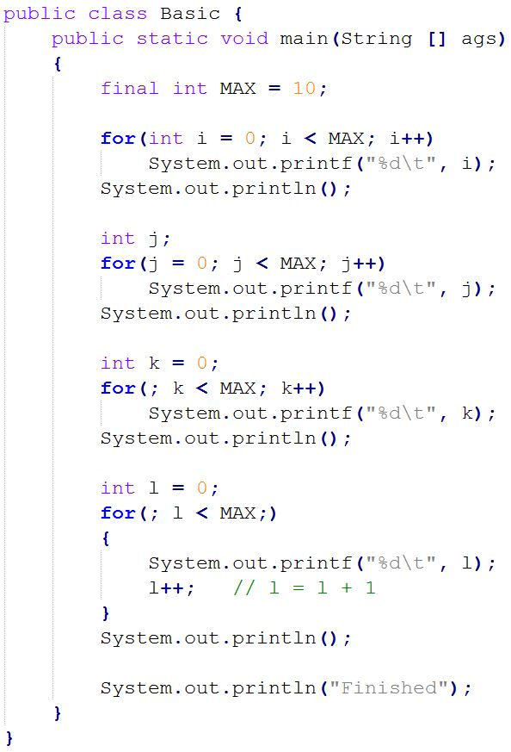
The initialization step is executed first, and only once. This step allows you to declare and initialize any loop control variables. You are not required to put a statement here, as long as a semicolon appears.
After the body of the for loop executes, the flow of control jumps back up to the update statement. This statement allows you to update any loop control variables. This statement can be left blank, as long as a semicolon appears after the Boolean expression.

Slide 7
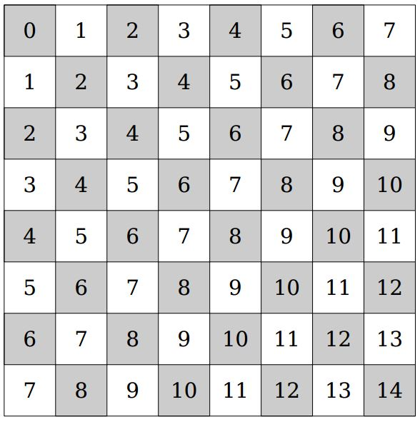
Exercise
Use double nested loop to generate output

Slide 8
Arrays
Say that you are writing a program that reads in 100 numbers. Would you like to declare 100 variables and write 100 input statements?
Probably not. It would be useful to have an organized way of reading and storing the values.
An array is an object that is used to store a list of values. It is made out of a contiguous block of memory that is divided into a number of cells. Each cell holds a value, and all the values are of the same type. Sometimes the cells of an array are called slots.

Slide 9
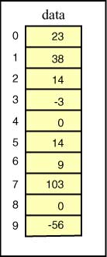
In the example array pictured at right, each cell holds an int.
The name of this array is data. The cells are indexed 0 through 9. Each cell can be accessed by using its index. For example, data[0] is the cell which is indexed by zero (which contains the value 23). data[5] is the cell which is indexed by 5 (which contains the value 14).
Facts:
The cells are numbered sequentially starting at zero.
If there are N cells in an array, the indexes will be 0 through N-1.
The value stored in a cell of an array is sometimes called an element of the array. An array has a fixed number of cells. The values in the cells (the elements) can be changed.
What is the value of the
arithmetic expression
data[2] + data[6]

Slide 10
In the example array pictured at right, each cell holds an int.
The name of this array is data. The cells are indexed 0 through 9. Each cell can be accessed by using its index. For example, data[0] is the cell which is indexed by zero (which contains the value 23). data[5] is the cell which is indexed by 5 (which contains the value 14).
Facts:
The cells are numbered sequentially starting at zero.
If there are N cells in an array, the indexes will be 0 through N-1.
The value stored in a cell of an array is sometimes called an element of the array. An array has a fixed number of cells. The values in the cells (the elements) can be changed.
What will be the result of
executing the statement
data[0] = data[6] + 8;

Slide 11
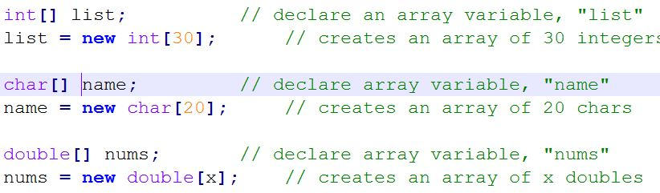
Two steps for creating Arrays:
Step 1: Declare an array variable (a reference to the array)
Step 2: Create the array
Formats for declaring an array variable:
type[] arrayName; // preferred
type arrayName[]; // alternate form
Format for creating the array (with the operator new)
arrayName = new type[size];
Note type should match the type of the arrayName variable
Examples:

Slide 12

Combined format:
type[] arrayName = new type[size];
Examples:
The array's size is stored in arrayName.length.
For example, the size of the "list" array above is: list.length

Slide 13

The following format can be used to declare, create, and initialize an array in one line. (Note that this also bypasses the new operation, which is implicit):
type[] arrayName = { initializer list };
The initializer list is a comma-separated list of array values. From this, the compiler can figure out the number of elements when creating the array. Examples:

Slide 14
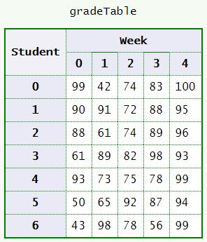
2D Array
Often data comes naturally in a two dimensional form.
Imagine a class of 7 students that have a quiz every week for 5 weeks. The instructor records the grades in a table. A particular cell of the table is designated by student number and week number. For example:
The grade for student 0 week 1 is 42
The grade for student 3 week 4 is 93
The grade for student 6 week 2 is 78
A compact notation for specifying a cell
uses the row and column indexes like this:
gradeTable[ row ][ col ]
As with one dimensional arrays, indices start at zero. For example:
gradeTable[ 0 ][ 1 ] is 42
gradeTable[ 3 ][ 4 ] is 93
gradeTable[ 6 ][ 2 ] is 78

Slide 15
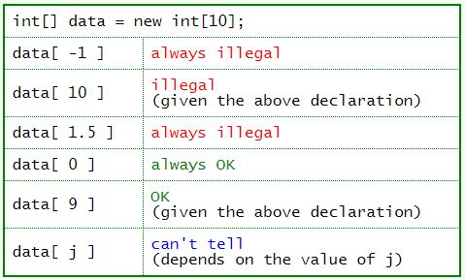
Bounds Checking
Recall that:
The length of an array is how many cells it has. An array of length N has cells indexed 0..(N-1)
Indexes must be an integer type. It is OK to have spaces around the index of a subscripted variable, for example data[1] and data[ 1 ] are exactly the same as far as the compiler is concerned.
It is not legal to refer to a cell that does not exist.
Say that an array were declared:
int[] data = new int[10];
The table shows some subscripted variables of this array.
If your program contains an expression that is always illegal, it will not compile. But often the size of an array is not known to the compiler. The size of an array often is determined by data at run time. Since the array is constructed as the program is running, the compiler does not know its length and can't detect some errors.
As a Java program is running, each time an array index is used it is checked to be sure that it is OK. This is called bounds checking, and is extremely important for catching errors. If an executing program refers to a cell that does not exist, an ArrayIndexOutOfBoundsException is thrown, and (usually) the program is terminated.

